Slide 1
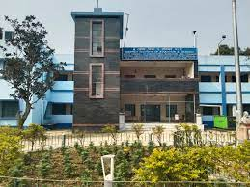
Diet , hooghly
West Bengal Board Of Primary Education
SESSION – 2022-2024
Student’s Name – Ankita Das
Student’s Roll – 88
Course Code –
Project Name –
Submission Date -

